Slide 1
Mini Project on
Image Classification (Cats and Dogs)

Slide 2
Deep Learning
Deep learning is a class of machine learning algorithms that:
use a cascade of multiple layers of nonlinear processing units for feature extraction and transformation. Each successive layer uses the output from the previous layer as input.
learn in supervised (e.g., classification) and/or unsupervised (e.g., pattern analysis) manners.
learn multiple levels of representations that correspond to different levels of abstraction; the levels form a hierarchy of concepts.
use some form of gradient descent for training via backpropagation.

Slide 3
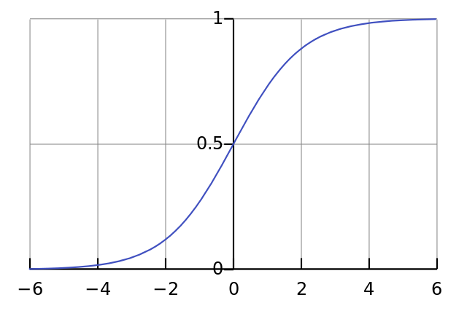
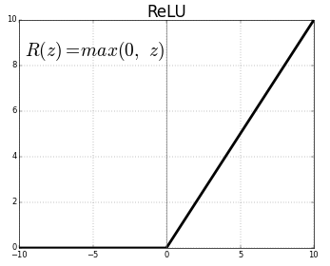
Sigmoid
Relu

Slide 4
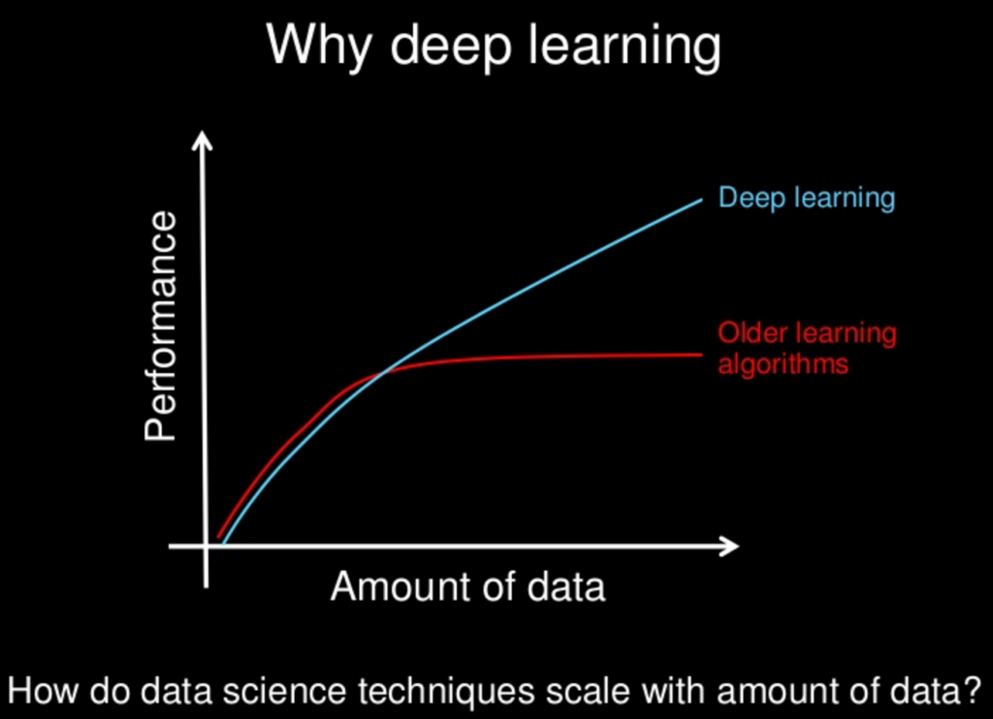

Slide 5
Convolutional Neural Network
Convolutional networks were inspired by biologicalprocesses^{[4]} in which the connectivity pattern between neurons is inspired by the organization of the animal visual cortex. Individual cortical neurons respond to stimuli only in a restricted region of the visual field known as the receptive field. The receptive fields of different neurons partially overlap such that they cover the entire visual field.

Slide 6
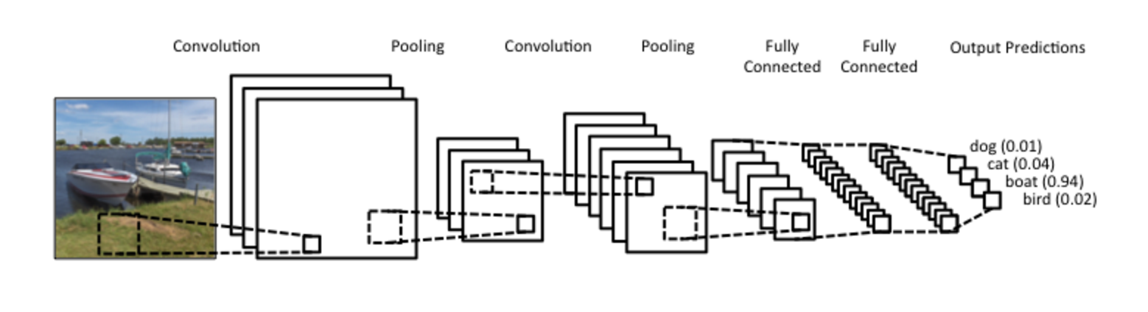

Slide 7
Libraries Used
Keras
PIL
Scipy
Matplotlib

Slide 8
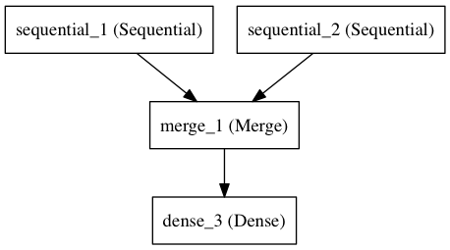
Sequential Model
The Sequential model is a linear stack of layers.

Slide 9
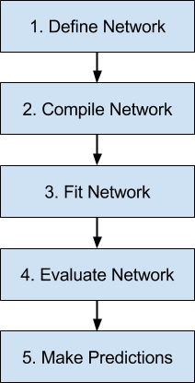
Architecture

Slide 10
Convolution2D layer
Convolution operator for filtering windows of two-dimensional inputs.
classifier.add(Convolution2D(nb_filter, (row, column ), activation = 'relu'))
Arguments
nb_filter: Number of convolution filters to use.
nb_row: Number of rows in the convolution kernel.
nb_col: Number of columns in the convolution kernel.
activation: name of activation function to use

Slide 11
MaxPooling2D
Max pooling operation for spatial data.
classifier.add(MaxPooling2D(pool_size = (2, 2)))

